Slide 1


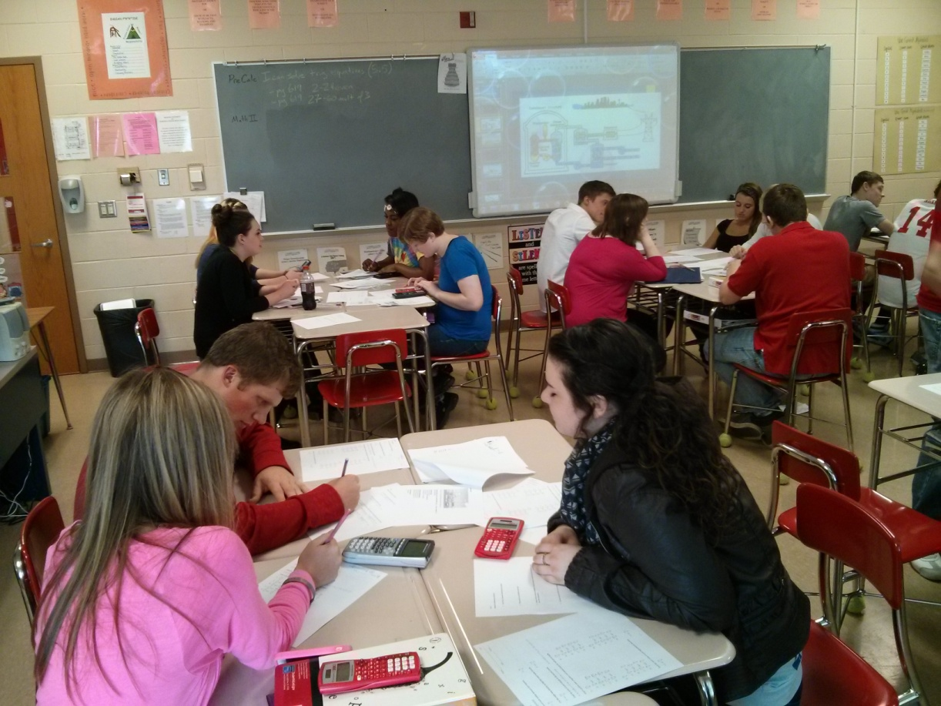
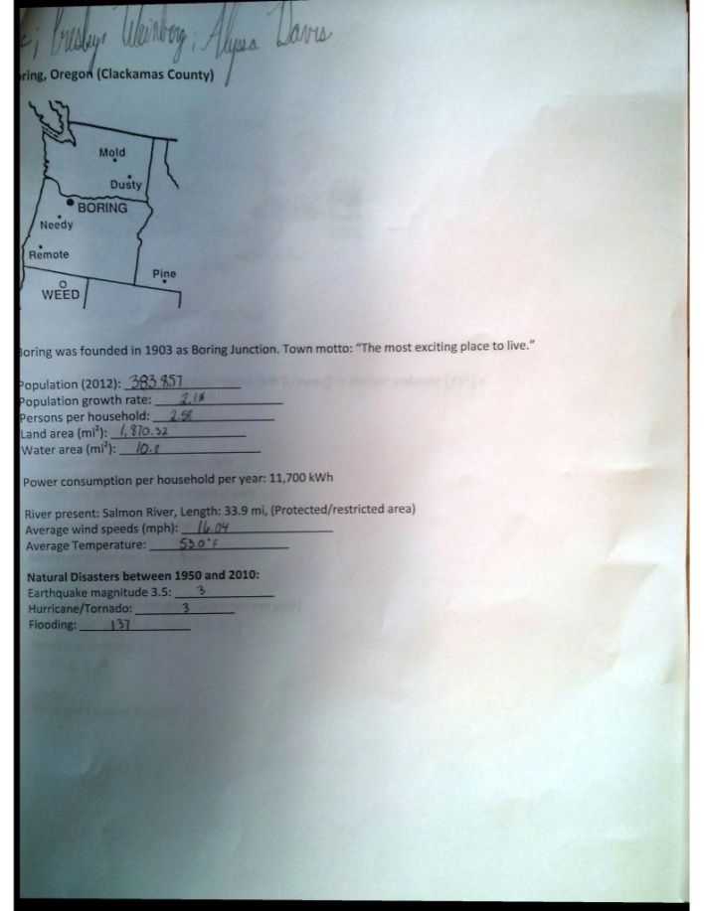
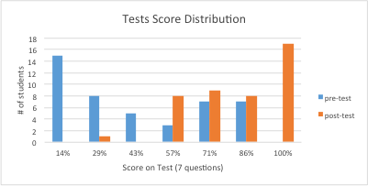
Energy Planning using Mathematics
COFSP Fellow
Fairfield H.S. Pre-Calculus
RET is funded by the National Science Foundation, grant # EEC 0808696.
Unit Overview
Unit Activity Implementation
Student Work
Topic: Real World Math Applications
Standards: Common Core State Standards – Mathematics (CCSS)
Next Generation Science Standards (NGSS)
Day 0: Pre-test
Day 1: Evaluating the different sources of energy
Show students first half of PowerPoint, showing various sources of electricity
Ask guiding questions.
Show 2nd half PowerPoint explaining all sources of energy.
Students will be choose their area and for homework, they must research that geo facts of area.
Day 2: Student will evaluate the population and the increasing need
Supply students with correct geo facts
Group must calculate population in 30 years
Group must calculate required electricity
Evaluate what sources of electricity your area qualifies for
Day 3: Design electricity supply
Group must “design” a combination of electricity sources that will suffice their need.
Present to class, cheapest combination will win a prize
Post-test
Students worked in groups.
Students designed by filling in the worksheets
Assessment Results:
Impact on Student Learning
Activity Structure
This Activity covered all aspects of math for real world application. The pre and post test given was the same.
Students currently taking Physics generally performed better.
Title: Energy Planning using Mathematics
Guiding Questions:
Name different sources of electricity?
What is the population of USA?
Why must we plan ahead for years to come?
Objectives:
After completing this activity, each student will be aware of:
Multiple sources of electrical power.
How to calculate population growth.
Devise formulae to calculate how much electricity is needed for increasing population.
Evaluate all sources of energy based on supplied criteria supplied
Use probability and statistics to estimate future occurrence of natural disasters
Apply ratios in measures
Use trigonometry to design a hydrodam
Basic design of wind turbine, hydrodam, nuclear power plant (basic structure).
Engineering Design Process
Reflection and Conclusion
All 7 steps of EDP & Addressing Real World Problems, Careers and Societal Impact (ACS), utilized.
Step 1: Students identified problem
Step 2: Criteria and Constraints were supplied
Step 3 & 4: Students calculated energy requirements based on info of area.
Step 5: Based on area restrictions, students evaluated what source of electricity they can design.
Step 6: Energy supply combinations were tried in order to supply adequate electricity to population
Step 7 & 8: Students designed electricity source and refined calculations after review.
Key objective was achieved. Students are exposed to math applications in the real world.
One student summarized this as a “long fun word problem”.
If I had grasped their attention better on the first day, I could have possible saved some time in the activity implementation.
I would have allowed the students more time to come up with answers to the guiding questions so that they can better picture the activity without me explaining it.

